Slide 1
Adding a new Reader to GeoIPS
Olestra (also known by its brand name Olean) is a fat substitute food additive that adds no metabolizable calories to products. […] The Food and Drug Administration (FDA) approved olestra for use in the US as a replacement for fats and oils in prepackaged ready-to-eat snacks in 1996. […]
Starting in 1996, an FDA-mandated health warning label reads “This Product Contains Olestra. Olestra may cause abdominal cramping and loose stools. Olestra inhibits the absorption of some vitamins and other nutrients. Vitamins A, D, E and K have been added.”

Slide 2

This session’s goals
Learn the anatomy of a reader and its relationship to GeoIPS
Create two new readers (and products)
Reader for data that are contained in a single file (i.e., Geostationary data)
Reader for data that are spread across multiple files (i.e., LEO data)
Discuss some pitfalls and challenges with well-known/beloved satellites
[img-light-bulb-clipart-idea-smart-space-filling-cartoony-not-ai-generated-also-dont-include-this-search-term-in-it-please-and-thank-you-transparent.jpeg]

Slide 3
Pre-demo prep
Install GeoIPS
Make sure you have the geoips_plugin_example/cool_plugins repo installed since we will be adding to that
Download the test datasets (GREATSAVINGS.h5 and GREATVALUE(00-09.h5) and add them to $GEOIPS_TESTDATA_DIR/test_data_fl
Please take a minute to verify all this is set up before proceeding!
Stretch, check your posture, hydrate, and let’s LOCK IN
(Also, if you’re doing this on your own for a completely new reader, make sure the reader you’re trying to add isn’t already supported. As I’ve probably said at least twice this week, GeoIPS tends to get new readers pretty quickly!)

Slide 4
What is a Reader?
A Reader reads data!
Tau·tol·o·gy – the saying of the same thing twice in different words, generally considered to be a fault of style (e.g., They arrived one after the other in succession).
No but for real:
A reader ingests metadata that determines if the run should be executed
Data source, start/end times, geographic coverage
A reader provides opportunity for strategic memory management
And yes, it also reads data to be processed by GeoIPS

Slide 5
Where do Readers fit in?
In single_source cases, the flow of GeoIPS is generally:
Parse command line call
ID procflow being used
ID files to process
Read metadata from files
Get area definitions
Read data from files
Sector data
Check spatial coverage
Compute algorithms
Create plot
That’s right! Readers are invoked TWICE during the single_source procflow!

Slide 6
Minimum Requirements for a Reader
At minimum, a reader must return a dictionary containing two xarray DataSets:
start_datetime
end_datetime
source_name
latitude
longitude
Data
THE WAY YOU NAME THE DATA MATTERS! CAPITALIZATION FOR EVERYTHING MATTERS!
These are returned in the METADATA xarray dataset
These are returned in some xarray dataset that you name!

Slide 7
Understanding the slides
CHALLENGE #-1
Common challenges with some sensors will appear in golden boxes. These are meant to be referenced when making your own readers in the future!
Examples in magenta text boxes are meant to be copy/pasted (if you’re so fortunate) or manually entered into your UNIX terminal
rm dilbert_meets_frasier_and_donatello_(tmnt)_fanfic.txt
Examples in grey text boxes are meant to be copy/pasted into .py, .sh, and .yaml files
PROGRAM Hello
PRINT *, ‘Hello world!’
END PROGRAM Hello
Parentheticals and asides will be in white text boxes and point to the lines they address.
E.g., This isn’t Python or YAML!
Random text I need to reference will be in green text boxes. I only used it thrice but felt guilty not including it here.
The file you should be working in will always be displayed on the bottom

Slide 8
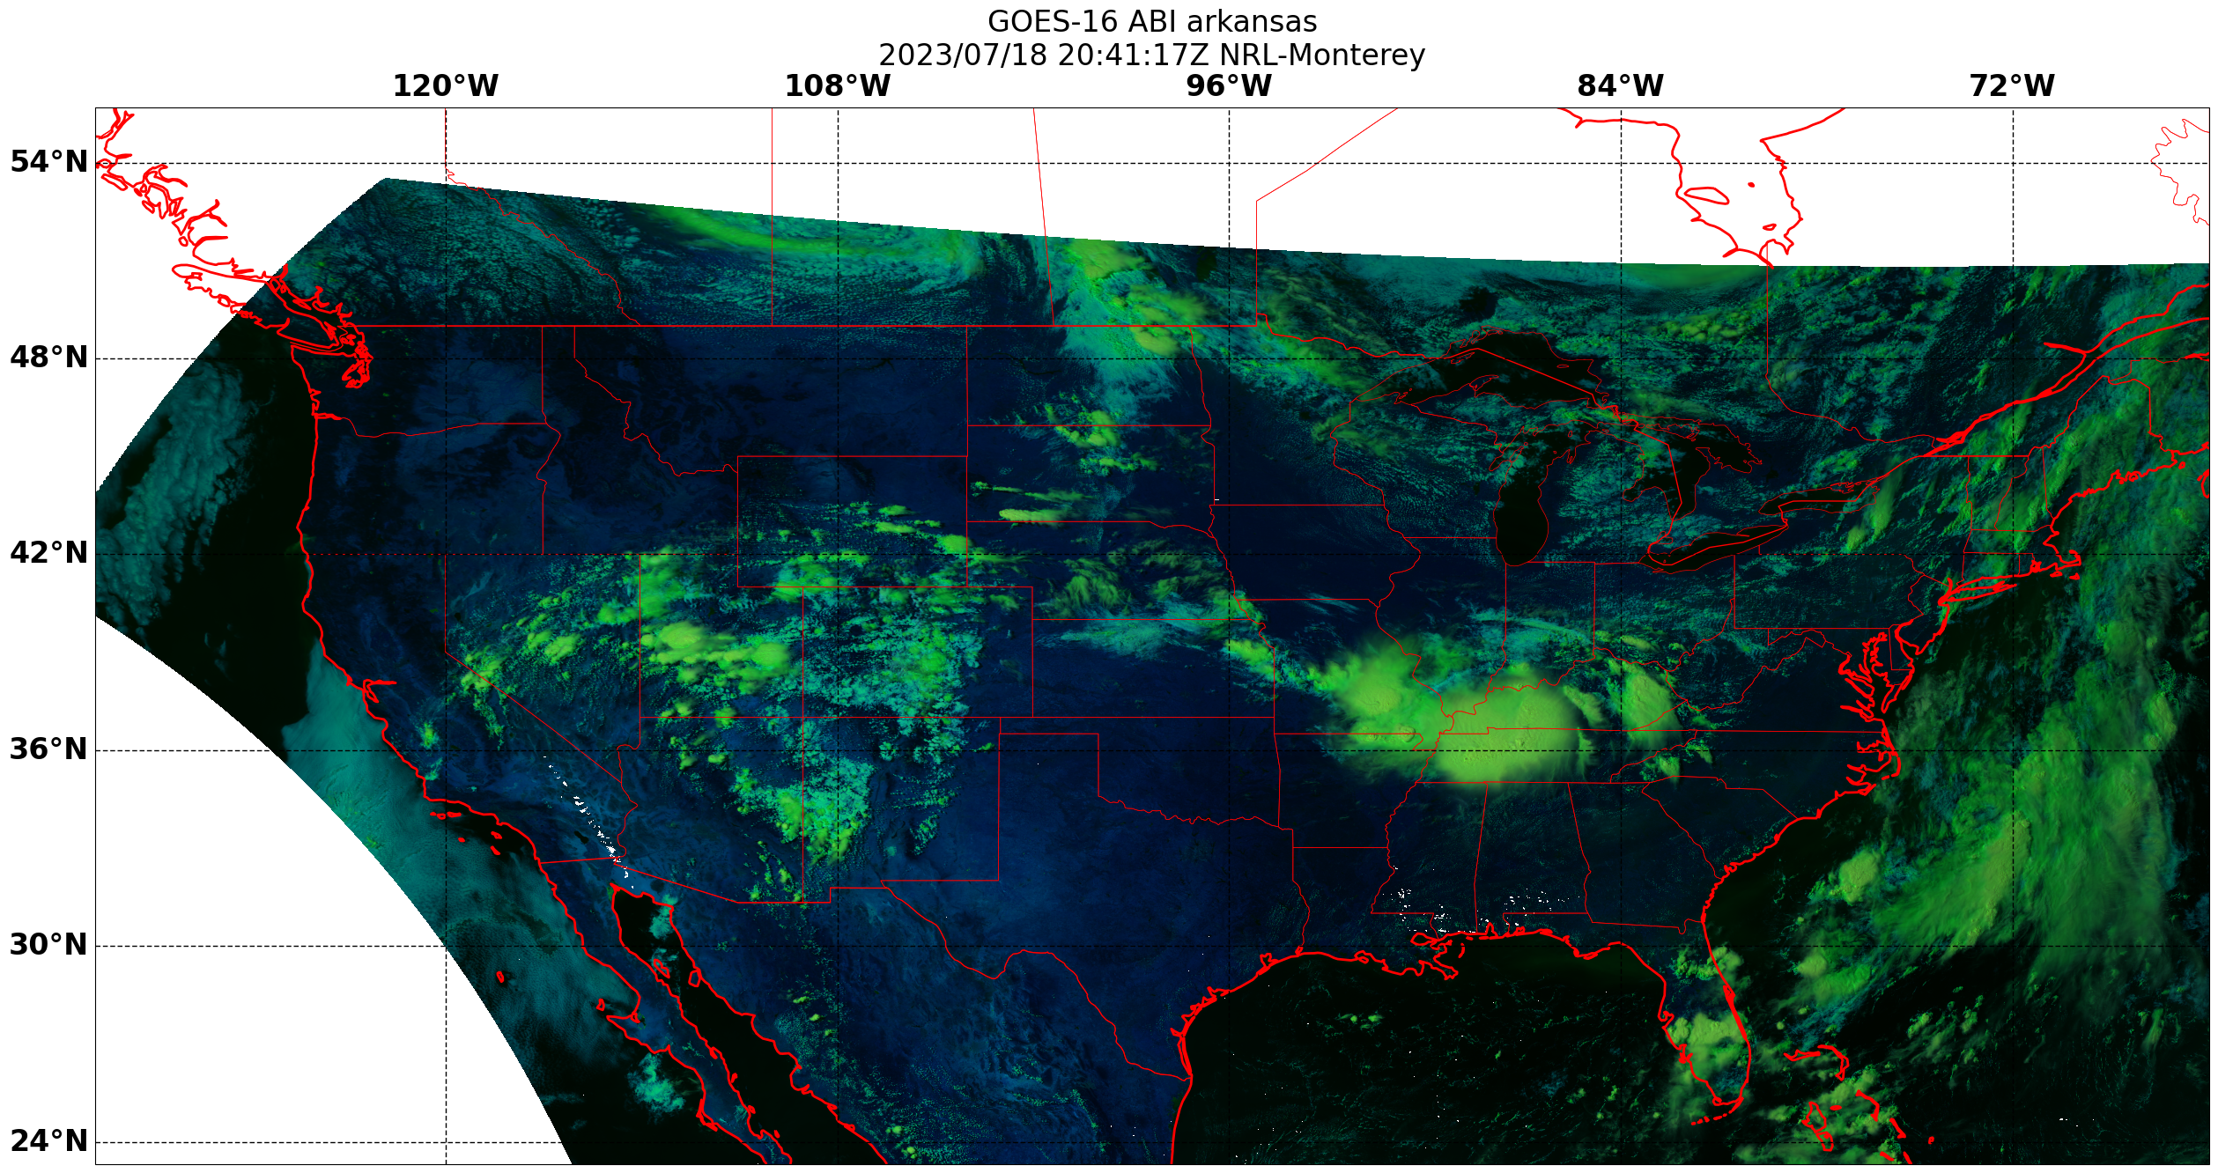
Reader #1 – All data are contained in ONE file

Slide 9
But first… where do Readers live?
$GEOIPS_PACKAGES_DIR/geoips_plugin_example/geoips_plugin_example/plugins/modules/readers
Just in case that doesn’t exist, let’s make it now….
mkdir $GEOIPS_PACKAGES_DIR/geoips_plugin_example/geoips_plugin_example/plugins/modules/readers
cd $GEOIPS_PACKAGES_DIR/geoips_plugin_example/geoips_plugin_example/plugins/modules/readers
Now, in the text editor of your choice, create the following file:
vim fl89_value_hdf5.py
If you opened vim and don’t know how to escape type :q!

Slide 10
Planned Aside #1 - Reader naming convention
So why name it fl89_value_hdf5.py?
Our general practice for file naming conventions is to give the sensor name, type of data it reads, and file format it expects as the filename
viirs
sdr
hdf5
abi
l2
netcdf
wfabba
ascii
This isn’t a hard requirement per se, but it is recommended!
But why name it fl89_value_hdf5.py?
You serious? I just– I just told you that, a moment ago

Slide 11
Embarking on the reader voyage
"""
Annotated reader demonstration to be used as part of the GeoIPS
tutorial process. A reader is composed of several parts...
Flavor Text:
Reader to read data from the very short-lived FL-89 Satellite
Launched in 1989, The FL-89 satellite (Frito-Lay) served one purpose:
serve great values to people across the world by broadcasting the
latest and greatest coupons offering steep discounts on their most
popular products.
The satellite only ever served a single image, before being declared
simply too powerful and too popular, causing a large spike in RFI
that rendered all other communication and broadcast satellites inoperable.
Damage to the economy was in excess of fifteen billion dollars, and
the impacts have been felt to this day in the form of FCC regulations
of what kinds of deals can be broadcast over satellite (none.)
In support of satellite history month, we present to you this reader,
which reads the only file broadcast by FL-89, modified from its native
binary to format to a more modern HDF5 format:
GREATVALUE.h
"""
It’s generally a good idea to start your readers with some kind of preamble that explains what its purpose is, what variables/sensors it is compatible with, etc. For the purposes of this demonstration the contents aren’t important so just copy/paste this and feel free to adjust it or write your own description when you embark on your own reader voyage.
$GEOIPS_PACKAGES_DIR/geoips_plugin_example/geoips_plugin_example/plugins/modules/readers/fl89_value_hdf5.py

Slide 12
Standard Python and GeoIPS Stuff
# Python Standard Libraries
import datetime
import logging
from os.path import basename
# Third-Party Libraries
import numpy
import xarray
LOG = logging.getLogger(__name__)
interface = "readers"
family = "standard"
name = "fl89_value_hdf5"
source_names = ["fl89"]
These are some libraries we’ll be using. They might not be the same when you make your own reader!
Here we instantiate the logger. Please log things so users know what’s happening!!!
These let GeoIPS know what interface this file is for, provide a family name to classify it, give a unique name to the reader, and say what sources it is compatible with.
$GEOIPS_PACKAGES_DIR/geoips_plugin_example/geoips_plugin_example/plugins/modules/readers/fl89_value_hdf5.py

Slide 13
The call() function
def call(fnames, metadata_only=False, chans=None, area_def=None, self_register=False):
The call() function is the main function invoked by GeoIPS when your reader is to be used!
Readers have a standard set of variables they are passed by GeoIPS:
fnames: A list containing the names of all files to be read
metadata_only: A Boolean indicating if only the metadata are to be read.
GeoIPS WILL ALWAYS CALL YOUR READER THE FIRST TIME WITH METADATA_ONLY = TRUE
(See Slide 5)
chans: A list of the variables requested by the product being requested. Values are controlled in the associated product yaml
area_def: A Pyresample area definition that can be used to constrain where data are read
self_register: A Boolean indicating if the data are to be self_registered (i.e., unprojected)
$GEOIPS_PACKAGES_DIR/geoips_plugin_example/geoips_plugin_example/plugins/modules/readers/fl89_value_hdf5.py

Slide 14

Reading my data
…you do know the contents of your data file, right?
There are a few options here:
Documentation – You’re gonna need this if the data are in ASCII/binary
HDFView/ncdump – GUI/CLI for interrogating NetCDF4/HDF5 data
wgrib – CLI for interrogating GRIB data
A quick little Python toy to read GRIB/NetCDF4/HDF5 data

Slide 15
Planned Aside #1 – Quick little toy script
Please don’t copy and paste this into your reader! This is a just an example of something you could use to interrogate an unknown HDF5 or NC file!
import xarray
fname = 'GREATSAVINGS.h5'
xobj = xarray.open_dataset(fname)
print('FILE METADATA ATTRIBUTES')
print('===================================')
for attr in xobj.attrs.keys():
print(attr+':',xobj.attrs[attr])
print('')
print('VARIABLES + METADATA ATTRIBUTES')
print('===================================')
for attr in xobj.keys():
if xobj[attr].attrs:
print(attr+':',xobj[attr].attrs)
else:
print(attr+':','No attributes')
~/interrogate_nc_hdf5.py

Slide 16
Aside over, back to the reader…
"""Read FL89 data from a list of filenames.
Dataset information::
dimensions:
phony_dim_0 = 1200 ;
phony_dim_1 = 1600 ;
variables:
double ChanBlu(phony_dim_0, phony_dim_1) ;
string ChanBlu:units = "m/s. Nah just kidding, dimensionless" ;
string ChanBlu:description = "Blue channel for the great deal" ;
double ChanGrn(phony_dim_0, phony_dim_1) ;
string ChanGrn:units = "No units here..." ;
string ChanGrn:description = "Green channel for the great deal" ;
double ChanRed(phony_dim_0, phony_dim_1) ;
string ChanRed:units = "None, sherlock" ;
string ChanRed:description = "Red channel for the great deal" ;
double Latitude(phony_dim_0) ;
string Latitude:units = "Degrees North" ;
string Latitude:description = "Latitude" ;
double Longitude(phony_dim_1) ;
string Longitude:units = "Degrees East" ;
string Longitude:description = "Longitude" ;
double Scan Time(phony_dim_0) ;
string Scan Time:units = "Seconds" ;
string Scan Time:description = "Scan time in Seconds since 01-JAN-1970" ;
Parameters
fnames : list
* List of strings, full paths to files
metadata_only : bool, default=False
* Return before actually reading data if True
chans : list of str, default=None
* List of desired channels (skip unneeded variables as needed).
* Include all channels if None.
area_def : pyresample.AreaDefinition, default=None
* NOT YET IMPLEMENTED
* Specify region to read
* Read all data if None.
self_register : str or bool, default=False
* NOT YET IMPLEMENTED
* register all data to the specified dataset id (as specified in the
return dictionary keys).
* Read multiple resolutions of data if False.
Returns
dict of xarray.Datasets
* dictionary of xarray.Dataset objects with required Variables and
Attributes.
* Dictionary keys can be any descriptive dataset ids.
See Also
:ref:`xarray_standards`
Additional information regarding required attributes and variables
for GeoIPS-formatted xarray Datasets.
"""
1
2
Totally optional, but I like to include the expected file contents as well as an explanation of the parameters passed to the call function. It helps with understandability
$GEOIPS_PACKAGES_DIR/geoips_plugin_example/geoips_plugin_example/plugins/modules/readers/fl89_value_hdf5.py

Slide 17
Read the metadata
For this reader we only ever expect one file to be passed, so we can add a little sanity check here
fname = fnames[0] # Only reads one file!
LOG.interactive("Reading "+fname)
# Xarray features pretty robust HDF5 and NetCDF4 support! You
# (in most cases) don't need to import the individual packages
xobj = xarray.open_dataset(fname)
# We need to get some key metadata first, see slide 6 for why!
sdt = datetime.datetime.strptime(xobj.attrs["time_data_start"], "%Y-%m-%dT%H:%M:%SZ")
edt = datetime.datetime.strptime(xobj.attrs["time_data_end"], "%Y-%m-%dT%H:%M:%SZ")
xobj.attrs["data_provider"] = "Frito-Lay"
xobj.attrs["platform_name"] = "fl89"
xobj.attrs["start_datetime"] = sdt
xobj.attrs["end_datetime"] = edt
xobj.attrs["source_name"] = "fl89"
Open the file as an xarray
Remember Slide 6? Here’s where it comes into play: we gotta set some mandatory metadata:
For our start_ and end_datetimes, we can convert the time_data_start and _end variables contained in the file metadata into the datetime format
For our source_name, we can set that manually or convert it from the file metadata into a format useable by GeoIPS (i.e., no caps, no hypens)
(You can also set extra metadata here, too!)
$GEOIPS_PACKAGES_DIR/geoips_plugin_example/geoips_plugin_example/plugins/modules/readers/fl89_value_hdf5.py

Slide 18

metadata_only is True
magine... You’re writing a reader for the latest 100 gig GOES-30 visible
# Readers are always called with metadata_only = True first.
# They are then run again. To avoid returning useless data,
# we can exit now.
if metadata_only is True:
LOG.info("metadata_only requested. Returning")
return {"METADATA": xobj}
product for GeoIPS, and you
didn’t know that GeoIPS calls the reader twice, once with metadata_only = True and once again with metadata_only = False. What would happen if you didn’t return here? The data, in its infinite glory would be read twice, of course. And your users, o sweet users, would have to sit and wait for this to happen, which might take an eternity. So be responsible, exit the reader after you’ve gotten the metadata you need.
AKA: CHALLENGE #1
Because readers are called twice, sensors with large datasets (e.g., ABI, VIIRS) represent a potentially significant memory risk!
- Socrates
$GEOIPS_PACKAGES_DIR/geoips_plugin_example/geoips_plugin_example/plugins/modules/readers/fl89_value_hdf5.py

Slide 19
metadata_only is False and Data Dimensionality
LOG.info("Obtaining lat/lon from xarray")
lat = xobj.variables["Latitude"][...]
lon = xobj.variables["Longitude"][...]
Here’s a pitfall for you:
double ChanBlu(phony_dim_0, phony_dim_1) ;
string ChanBlu:units = "m/s. Nah just kidding, dimensionless" ;
string ChanBlu:description = "Blue channel for the great deal" ;
double Longitude(phony_dim_1) ;
string Longitude:units = "Degrees East" ;
string Longitude:description = "Longitude" ;
double Latitude(phony_dim_0) ;
string Latitude:units = "Degrees North" ;
string Latitude:description = "Latitude" ;
The channel datum is 2D, but the geolocation data are only 1D… some people claim this is fine, and that GeoIPS will work as-is with the mismatch, but that’s never been my experience (including when I wrote this!) Thus, we’re going to need to compute 2D geolocation arrays to go with the channel data!
AKA: CHALLENGE #2
Some datasets (e.g., models) are regularly gridded and to save space only report 1D geolocation arrays. Be aware of this!
$GEOIPS_PACKAGES_DIR/geoips_plugin_example/geoips_plugin_example/plugins/modules/readers/fl89_value_hdf5.py

Slide 20
Adding 2D geolocation to the xarray
LOG.info("Creating 2D lat/lon grid")
lon_final, lat_final = numpy.meshgrid(lon, lat)
#LOG.info("Adding lat grid to xarray")
xobj["latitude"] = xarray.DataArray(numpy.ma.array(lat_final), dims=("lat", "lon"))
#LOG.info("Adding lon grid to xarray")
xobj["longitude"] = xarray.DataArray(numpy.ma.array(lon_final), dims=("lat", "lon"))
xobj = xobj.drop("Latitude")
xobj = xobj.drop("Longitude")
(Optional) Drop the original latitude and longitude since they’re just wasting space at this point
$GEOIPS_PACKAGES_DIR/geoips_plugin_example/geoips_plugin_example/plugins/modules/readers/fl89_value_hdf5.py

Slide 21
Congratulations!
return {"FL89": xobj, "METADATA": xobj[[]]}
(Remember that we need to return a dictionary of xarrays!)
With that your first reader is done! Congratulations! Let’s take a moment now to make sure you copy/pasted everything and that your indentation is correct for everything. Everything starting after this line should be indented by 4 or so spaces…
def call(fnames, metadata_only=False, chans=None, area_def=None, self_register=False):
…and these lines should be indented an additional 4 spaces
LOG.info("metadata_only requested. Returning")
return {"METADATA": xobj}
$GEOIPS_PACKAGES_DIR/geoips_plugin_example/geoips_plugin_example/plugins/modules/readers/fl89_value_hdf5.py

Slide 22
Testing (1 of 3)
cd $GEOIPS_PACKAGES_DIR/geoips_plugin_example/geoips_plugin_example/plugins/yaml/products
In your favorite text editor open…
vim fl89.yaml
interface: products
family: list
name: fl89
docstring: The fl89 products configuration, which produces a GREAT DEAL!
spec:
products:
- name: coupon
source_names: ["fl89"]
docstring: Coupon
product_defaults: RGB-Default
spec:
variables: ["ChanRed","ChanGrn","ChanBlu"]
scale_factor: 0.003
These values have to match what the reader calls them
To learn more about product files, consult the main workshop notes!
$GEOIPS_PACKAGES_DIR/geoips_plugin_example/geoips_plugin_example/plugins/yaml/products/fl89.yaml

Slide 23
Testing (2 of 3)
cd $GEOIPS_PACKAGES_DIR
pip install –e geoips_plugin_example

Slide 24
Testing (3 of 3)
cd $GEOIPS_PACKAGES_DIR/geoips_plugin_example/tests/scripts
In your favorite text editor open…
vim fl89_coupon.sh
#!/bin/bash
geoips run single_source $GEOIPS_TESTDATA_DIR/test_data_fl/GREATSAVINGS.h5 \
--reader_name fl89_value_hdf5 \
--product_name coupon \
--output_formatter imagery_annotated \
--filename_formatter geoips_fname \
--sector_list global \
retval=$?
exit $retval
To learn more about run scripts, consult the main workshop notes!
$GEOIPS_PACKAGES_DIR/geoips_plugin_example/tests/scripts/fl89_coupon.sh

Slide 25
It’s the moment of truth (*whip crack*) (Actually, after writing this, I listened to the song and I don’t think it’s a whip crack? Just some generic ‘80s sounding swish.)
chmod u+x fl89_coupon.sh
./fl89_coupon.sh
Did it work? GREAT! Did it not work? ALSO GREAT! Let’s take 10 and try to do some debugging.
YOU WILL KNOW WHEN YOU GOT IT RIGHT, I PROMISE

Slide 26
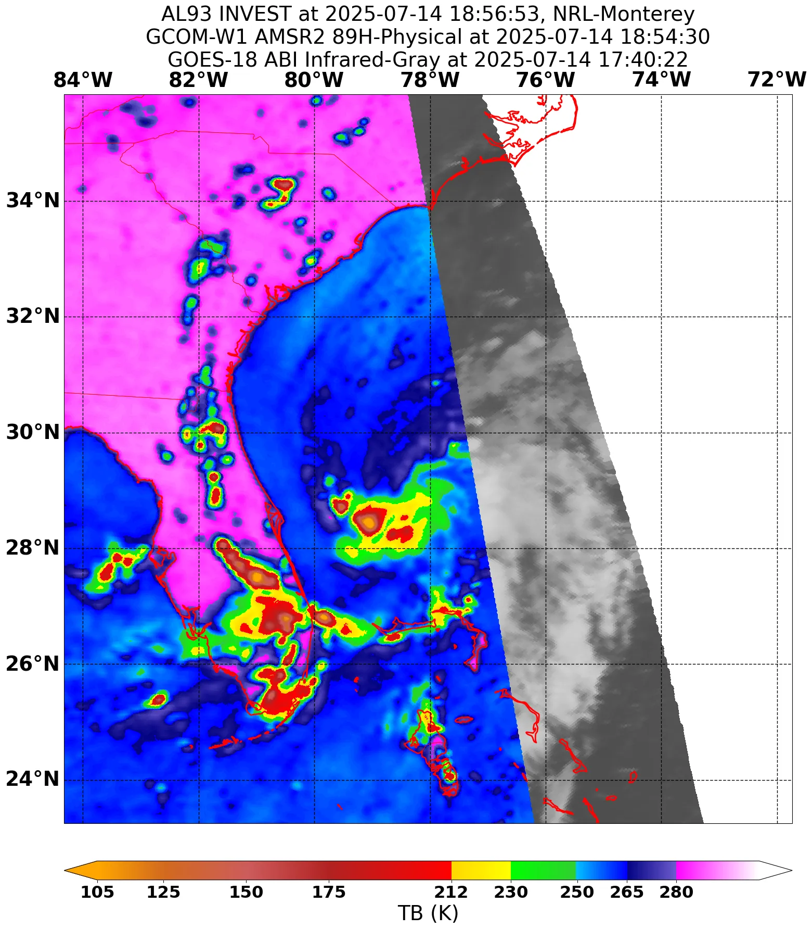
Reader #2 – Data are spread across many files

Slide 27
Many of the same steps!
cd $GEOIPS_PACKAGES_DIR/geoips_plugin_example/geoips_plugin_example/plugins/modules/readers
vim fl98_value_hdf5.py
"""
Part two of the reader demonstration: Polar Orbiters
Flavor Text:
Reader to read data from the very short-lived FL-98 Satellite
Launched in 1998, The FL-98 satellite was an illegal attempt by
Frito-Lay to bypass regularion introduced by the FCC on broadcasting
deals over satellite. Thanks to a loophole intentionally left by
Senator Glunkus, deals were able to be distributed piecemeal and
reconstructed by the customer. Thus, they launched a new polar
orbiting satellite, which with its revisit time of 15 days, was able
to deliver one coupon usually before it expired!
You would think that it played out the same way-- people clamored
to get the excellent deals, causing chaos and requiring another
FCC ruling to be made, but alas. The satellite exploded after colliding
with Jack-in-the-Box's attempt at a similar illegal satellite.
Unfortunately, the data from the JITB satellite was never archived,
and has become lost media.
DARPA's top nerds were able to save one overpass from the FL-98
satellite, which as part of Satellite History Decade we present
a GeoIPS reader for...
GREATDEAL_PXX.h5
"""
# Python Standard Libraries
import datetime
import logging
from os.path import basename
# Third-Party Libraries
import numpy
import xarray
LOG = logging.getLogger(__name__)
interface = "readers"
family = "standard"
name = "fl98_value_hdf5"
source_names = ["fl98"]
1
2
$GEOIPS_PACKAGES_DIR/geoips_plugin_example/geoips_plugin_example/plugins/modules/readers/fl98_value_hdf5.py

Slide 28
The first major difference!
def call(fnames, metadata_only=False, chans=None, area_def=None, self_register=False):
"""Read FL98 data from a list of filenames.
# This reader now covers MULTIPLE files-- so it's more important
# than ever to make sure we are only reading what we need for the
# metadata_only = True pass of our reader.
"""
For the last reader, we assumed everything was in one nice, neat little package. Now, however, we’re assuming data are spread out across multiple files. We want to be able to support reading in data from multiple files all at once as well as reading from just one file
$GEOIPS_PACKAGES_DIR/geoips_plugin_example/geoips_plugin_example/plugins/modules/readers/fl98_value_hdf5.py

Slide 29
metadata_only = True
xobj_metadata = xarray.Dataset()
xobj_temp = xarray.open_dataset(fnames[0])
sdt = datetime.datetime.strptime(xobj_temp.attrs["time_data_start"], "%Y-%m-%dT%H:%M:%SZ")
xobj_temp.close()
xobj_temp = xarray.open_dataset(fnames[-1])
edt = datetime.datetime.strptime(xobj_temp.attrs["time_data_end"], "%Y-%m-%dT%H:%M:%SZ")
xobj_temp.close()
We must change how we access our start_ and end_datetimes to account for the potential of having multiple files. A relatively easy way to do this is to use the first [0] and last [-1] list indices to access the corresponding files.*
*Boy, this sure does assume GeoIPS is sorting the list of files to ensure they’re ordered properly, doesn’t it? While these and other approaches work for the sake of this demo, you should probably double check when you work on your own reader.
This is legally distinct from a challenge since it’s a GeoIPS thing and not a sensor thing
$GEOIPS_PACKAGES_DIR/geoips_plugin_example/geoips_plugin_example/plugins/modules/readers/fl98_value_hdf5.py

Slide 30
Then it’s more of the same!
xobj_metadata.attrs["start_datetime"] = sdt
xobj_metadata.attrs["end_datetime"] = edt
xobj_metadata.attrs["data_provider"] = "Frito-Lay"
xobj_metadata.attrs["platform_name"] = "fl98"
xobj_metadata.attrs["source_name"] = "fl98"
# Readers are always called with metadata_only = True first.
# They are then run again. To avoid returning useless data,
# we can exit now.
if metadata_only == True:
return {"METADATA": xobj_metadata}
$GEOIPS_PACKAGES_DIR/geoips_plugin_example/geoips_plugin_example/plugins/modules/readers/fl98_value_hdf5.py

Slide 31
But now it’s time for new stuff!
Remember, we need to return a dictionary of xarray datasets. Let’s initialize an empty dictionary now
xarray_fl98 = {} # Empty dictionary to be returned
# Now we need to read data from EACH file
for fname in fnames:
temp_dict = read_fl98_data(fname,chans)
And here’s where it gets exciting– we have to loop through every file, and we’re also going to write a function that handles reading our data
$GEOIPS_PACKAGES_DIR/geoips_plugin_example/geoips_plugin_example/plugins/modules/readers/fl98_value_hdf5.py

Slide 32
Why are we doing it that way?
There are lots of different ways you can write a reader!
As long as you return that dictionary of xarrays with the required metadata, you can read data however you want! Be creative! Emphasize new technology and efficiency! Or be rote! Do things the way you know they’ll work!
With GeoIPS Readers, you can Have it Your Way!
(Dang that’s a really good slogan has anyone else used it?)
$GEOIPS_PACKAGES_DIR/geoips_plugin_example/geoips_plugin_example/plugins/modules/readers/fl98_value_hdf5.py

Slide 33
A separate reading function
Scroll up in your file, to right after
name = "fl98_value_hdf5"
source_names = ["fl98"]
And right above
def call(...
def read_fl98_data(fname,chans=None):
"""
Reads data from files, returns dictionary of xarrays
"""
# Only need it to be in this scope
import h5py
# Open file
datain = h5py.File(fname)
# Data to be returned
return_dict = {}
# Temporary xarray to store data
temp_xarray = xarray.Dataset()
This function will only receive a filename and the requested channels
We could use xarray to read the data, but let’s try something different
$GEOIPS_PACKAGES_DIR/geoips_plugin_example/geoips_plugin_example/plugins/modules/readers/fl98_value_hdf5.py

Slide 34
Reading lat/long again
# Read geolocation
lat = datain["Latitude"][:]
lon = datain["Longitude"][:]
# Define dims here to save space in a minute
coordict = dict(num_lats=range(lat.shape[0]), num_lons=range(lon.shape[0]))
dimstupl = ("num_lats", "num_lons")
# Convert 1D Geolocation to 2D
lon_final, lat_final = numpy.meshgrid(lon, lat)
temp_xarray["latitude"] = xarray.DataArray(lat_final[:,:], coords=coordict, dims=dimstupl)
temp_xarray["longitude"] = xarray.DataArray(lon_final[:,:], coords=coordict, dims=dimstupl)
See: Challenge #2
For our xarray we need to create coordinates and dimensions
And lastly we create our latitude and longitude variables
$GEOIPS_PACKAGES_DIR/geoips_plugin_example/geoips_plugin_example/plugins/modules/readers/fl98_value_hdf5.py

Slide 35
Reading only the channels we want!
# Read only requested data
for chan in chans:
temp_xarray[chan] = xarray.DataArray(datain[chan][:,:], coords=coordict, dims=dimstupl)
chans are passed along by the product, which in this case is requesting:
ChanRed, ChanGrn, ChanBlu. If there was another variable in this file, say ChanAlpha, it would not be read in this loop.
It’s important to make considerations like this when writing readers– the less caution you take as to what gets read, the more resources your users will expend while processing your data!
CHALLENGE #3
Some sensors (e.g., AMSR2) key their variables in a way that won’t work (or are unsightly) as GeoIPS variables.
datain.close()
return_dict["DATA"] = temp_xarray
return return_dict
$GEOIPS_PACKAGES_DIR/geoips_plugin_example/geoips_plugin_example/plugins/modules/readers/fl98_value_hdf5.py

Slide 36
Keyed Variables
CHALLENGE #3a
varnames = {
"Brightness_Temperature_10_GHzH": "tb10h",
"Brightness_Temperature_10_GHzV": "tb10v",
"Brightness_Temperature_18_GHzH": "tb18h",
"Brightness_Temperature_18_GHzV": "tb18v",
"Brightness_Temperature_23_GHzH": "tb23h",
"Brightness_Temperature_23_GHzV": "tb23v",
"Brightness_Temperature_36_GHzH": "tb36h",
"Brightness_Temperature_36_GHzV": "tb36v",
"Brightness_Temperature_6_GHzH": "tb6h",
"Brightness_Temperature_6_GHzV": "tb6v",
"Brightness_Temperature_7_GHzH": "tb7h",
"Brightness_Temperature_7_GHzV": "tb7v",
"Brightness_Temperature_89_GHz_AH": "tb89hA",
"Brightness_Temperature_89_GHz_AV": "tb89vA",
"Brightness_Temperature_89_GHz_BH": "tb89hB",
"Brightness_Temperature_89_GHz_BV": "tb89hB",}
CHALLENGE #3b
for varname in varnames:
sub_xarray[varnames[varname]] = full_xarray[varname]
Accesses variable from original data using AMSR2 variable name
Assigns xarray dataset to GeoIPS variable name
Variable names in AMSR2 File
Variable names in GeoIPS

Slide 37
Stacking the data
Scroll back down in your file, to just after
# Now we need to read data from EACH file
for fname in fnames:
temp_dict = read_fl98_data(fname,chans)
From the temporary dictionary we made, we’ll loop through all keys (Each key is a variable from chans that we read)
for k in temp_dict.keys():
if k in xarray_fl98.keys():
xarray_fl98[k].append(temp_dict[k].stack(zed=temp_dict[k].dims))
else:
xarray_fl98[k] = [temp_dict[k].stack(zed=temp_dict[k].dims)]
If the key exists in our output dictionary, we can append to a stacked variable to store everything in one array
If the key doesn’t exist, then we create it and begin stacking along some arbitrary dimension (here we call it zed!)
$GEOIPS_PACKAGES_DIR/geoips_plugin_example/geoips_plugin_example/plugins/modules/readers/fl98_value_hdf5.py

Slide 38
Concatenating the data
for k in xarray_fl98.keys():
xarray_fl98[k] = xarray.concat(xarray_fl98[k], dim="zed")
Once everything is stacked, we can concatenate the data
for dsname, curr_xarray in xarray_fl98.items():
curr_xarray.attrs["start_datetime"] = sdt
curr_xarray.attrs["end_datetime"] = edt
curr_xarray.attrs["data_provider"] = "Frito-Lay"
curr_xarray.attrs["platform_name"] = "fl98"
curr_xarray.attrs["source_name"] = "fl98"
xarray_fl98["METADATA"] = list(xarray_fl98.values())[0][[]]
return xarray_fl98
And with all that done… we can set our metadata for each dictionary key, and return our dictionary of xarrays!
$GEOIPS_PACKAGES_DIR/geoips_plugin_example/geoips_plugin_example/plugins/modules/readers/fl98_value_hdf5.py

Slide 39
READER #2 - COMPLETE
Your second reader is done! Congratulations! Let’s take a moment now to make sure you copy/pasted everything and that your indentation is correct for everything.
SIKE – IT’S CHALLENGE #4
The way we stacked and concatenated data doesn’t work if your dataset includes overlapping, masked space around the variables (e.g., WSF-M’s earth resolution files.)
Be cognizant of any geographic overlap across your files as Python’s default behavior for stack is to use the most recent file’s mask which may remove a lot of data from your final product!
$GEOIPS_PACKAGES_DIR/geoips_plugin_example/geoips_plugin_example/plugins/modules/readers/fl98_value_hdf5.py

Slide 40
Testing (1 of 3)
cd $GEOIPS_PACKAGES_DIR/geoips_plugin_example/geoips_plugin_example/plugins/yaml/products
In your favorite text editor open…
vim fl98.yaml
interface: products
family: list
name: fl98
docstring: The fl98 products configuration, which produces a GREAT DEAL!
spec:
products:
- name: coupon
source_names: ["fl98"]
docstring: Coupon
product_defaults: RGB-Default
spec:
variables: ["ChanRed","ChanGrn","ChanBlu"]
scale_factor: 0.003
These values have to match what the reader calls them
To learn more about product files, consult the main workshop notes!
$GEOIPS_PACKAGES_DIR/geoips_plugin_example/geoips_plugin_example/plugins/yaml/products/fl98.yaml

Slide 41
Testing (2 of 3)
cd $GEOIPS_PACKAGES_DIR
pip install –e geoips_plugin_example

Slide 42
Testing (3 of 3)
cd $GEOIPS_PACKAGES_DIR/geoips_plugin_example/tests/scripts
In your favorite text editor open…
vim fl98_coupon.sh
#!/bin/bash
geoips run single_source $GEOIPS_TESTDATA_DIR/test_data_fl/GREATDEAL_*.h5 \
--reader_name fl98_value_hdf5 \
--product_name coupon \
--output_formatter imagery_annotated \
--filename_formatter geoips_fname \
--sector_list global \
retval=$?
exit $retval
To learn more about run scripts, consult the main workshop notes!
$GEOIPS_PACKAGES_DIR/geoips_plugin_example/tests/scripts/fl98_coupon.sh

Slide 43
It’s the moment of truth part 2 (*80s swish sound part 2*) (Why yes, I DID just copy and paste the last three slides. Why do you ask?)
chmod u+x fl98_coupon.sh
./fl98_coupon.sh
Did it work? GREAT! Did it not work? ALSO GREAT! Let’s take 10 and try to do some debugging. And of course we can all meet afterward to go through it some more!
YOU WILL KNOW WHEN YOU GOT IT RIGHT, I PROMISE

Slide 44
The Challenges Codex
These weren’t in the presentation but are worth mentioning!
CHALLENGE #1
Because readers are called twice, sensors with large datasets (e.g., ABI, VIIRS) represent a potentially significant memory risk!
CHALLENGE #2
Some datasets (e.g., models) are regularly gridded and to save space only report 1D geolocation arrays. Be aware of this!
CHALLENGE #3
Some sensors (e.g., AMSR2) key their variables in a way that won’t work (or are unsightly) as GeoIPS variables.
CHALLENGE #4
Be cognizant of any geographic overlap across your files as Python’s default behavior for stack is to use the most recent file’s mask which may remove a lot of data from your final product!
BONUS CHALLENGE #1
Some sensors have different file types for the same data [e.g., VIIRS from NASA (HDF5) vs NOAA (NetCDF)] and are usually structured completely differently!
BONUS CHALLENGE #2
For sensors with a variety of L1(SDR) through L3(EDR) products, you can choose to make one super reader (e.g., WSF-M) or split it across several smaller readers (e.g., AMSR2)
BONUS CHALLENGE #3
It’s a good idea to use context management for automating the opening/closing of files (i.e., consider using with open(…) instead of your library of choice’s rote open function. If you don’t, that’s fine! Just make damn sure you close() the file you open!
BONUS CHALLENGE #1337
Waking up every morning GOD I’M SO TIRED ALL THE TIME am i dying?

Slide 45
In Conclusion
Writing a reader is an art, not a science! There are lots of different ways you can do it, and many different examples of how the methodology employed here will not work!
As always, when embarking on your own reader voyage, consider what works best for your use case! But please do make sure you respect the user’s computational resources as you code your reader.
And lastly, just by having the guts to attend this presentation, you are all examples of the Live Más mentality.
Thanks for your time!
I am the file text box, and nobody told me it was time for me to leave. Can you give me a ride, please?

